Slide 1
B.Tech. Project
Data Driven Modelling of Composites
End Term Evaluation (4-2)
Advisor -
Prof. Siladitya Pal
Aman Shrivastava - 13117008
Mihir Ujjwal Rana - 13117044
Yash Sharma - 13117079

Slide 2
Project Objective
To develop an algorithmic framework to predict properties of composites to aid in meta-modelling process.

Slide 3
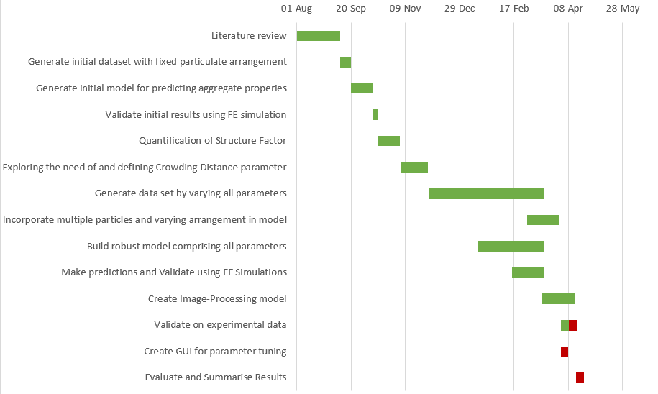
Project Timeline

Slide 4
General Workflow
Random Sequential Adsorption
FEM
Master Data
Images
Image Data Extraction
Trained Model
Machine Learning
Preprocessed Data
Predictions
Validation

Slide 5
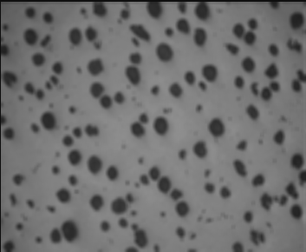
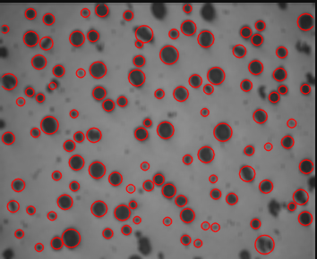
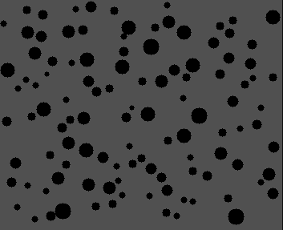
Image Data Extraction

Slide 6
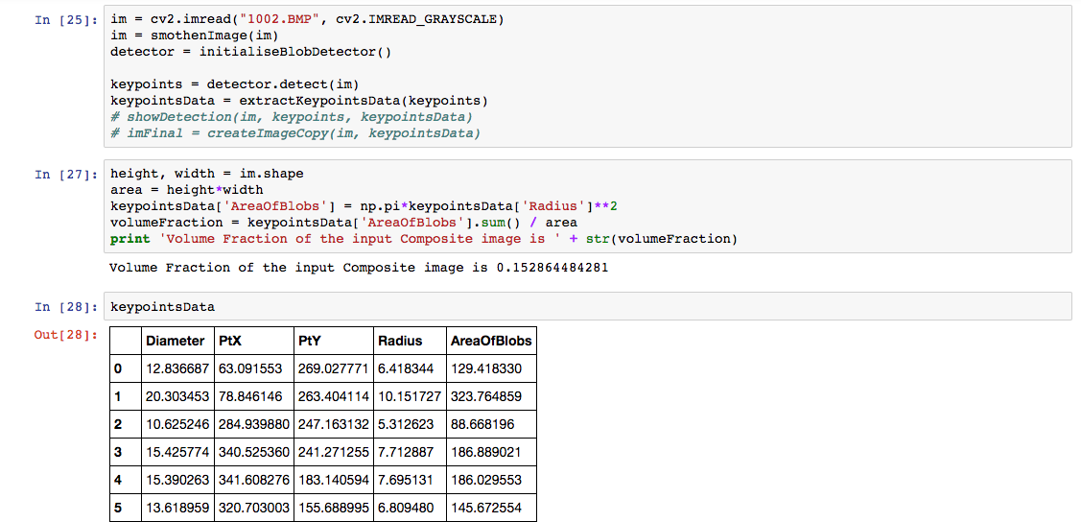
Image Data Extraction

Slide 7
Random Sequential Adsorption Model
To generate a statistically equivalent RVE, the hard-core model (also called the random sequential adsorption model) was used. This method creates a set of randomly distributed distributed points inside a square region, with the constraint that no pair of points may be closer points inside a square region, with the constraint that no pair of points may be closer than a certain minimum distance.
However, the RSA model does not permit the fiber volume fraction to be greater than ~54.7% due to the presence of fiber volume fraction to be greater than ~54.7% due to the presence of the so-called “jamming limit”.

Slide 8
Finite Element Method
Steps
Generate 5 microstructures for each composite for each volume fraction
Volume fraction = {0.3, 0.4, 0.5}
Plane strain (ϵ₁₁, ϵ₂₂, ϵ₁₂)
Composite range shown on the following slide
Obtain the average stress values
When L/d > 20, the difference observed due to spatial arrangement of particles is not significant
L = Length of unit cell, d = diameter of particles
Obtain tangent moduli (formulae shown later)
Feed tangent moduli data to ML model

Slide 9
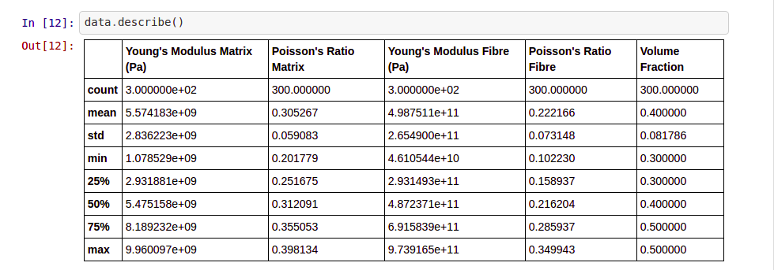
Description of Generated Data

Slide 10
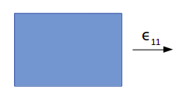
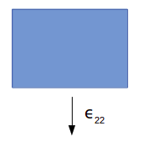
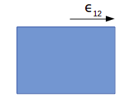




Tangent Moduli Formulae

Slide 11
Machine Learning
Training
Features:
Young’s Modulus of Matrix (E_{m})
Poisson’s Ratio of Matrix (ν_{m})
Young’s Modulus of Fibre (E_{f})
Poisson’s Ratio of Fibre (ν_{f})
Volume Fraction (Φ) - obtained from image / set to {0.3, 0.4, 0.5} while generation
Tangent Moduli (FEM)
Target:
Tangent Moduli (D₁₁₁₁, D₂₂₂₂, D₁₂₁₂)

Slide 12



Machine Learning
Algorithms:
XGBoost Regressor (XGB)
Random Forest Regressor (RF)
Ensemble of XGB and RF
After obtaining the tangent moduli, apply relevant formulae (given on next page) to get:
Young’s Modulus of composite (E_{m})
Shear Modulus of composite (D₁₂₁₂)
Poisson’s ratio of composite (ν_{c})

Slide 13
Procedure
We considered two composites with properties in our predictable range.
Glass (Fibre) - Epoxy (Matrix)
E_{f} = 71 GPa
ν_{f} = 0.22
E_{m} = 4 GPa
ν_{m} = 0.35
Boron (Fibre) - Epoxy (Matrix)
E_{f} = 420 GPa
ν_{f} = 0.2
E_{m} = 4 GPa
ν_{m} = 0.35

Slide 14
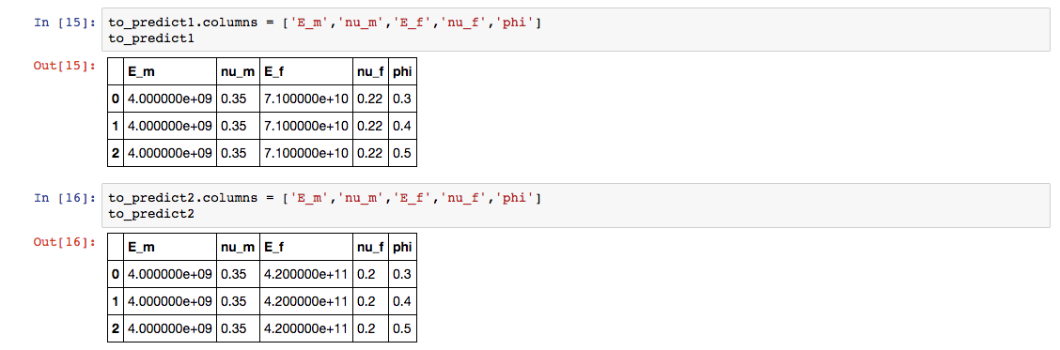
Procedure
Made predictions on three different volume fractions
Volume Fractions (Φ) = 0.3, 0.4, 0.5
Inputs - E_{m}, ν_{m}, E_{f} , ν_{f} , Φ

Slide 15
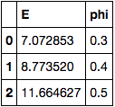
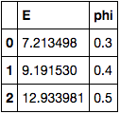
Procedure
Boron-Epoxy
Predictions
Glass-Epoxy

Slide 16
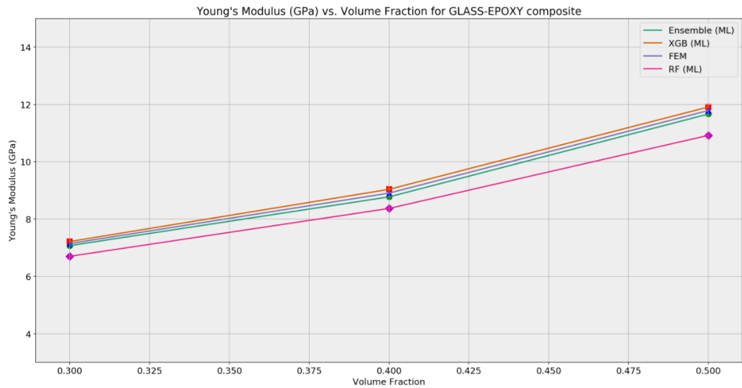
Accuracy Comparison (Young’s Modulus)

Slide 17
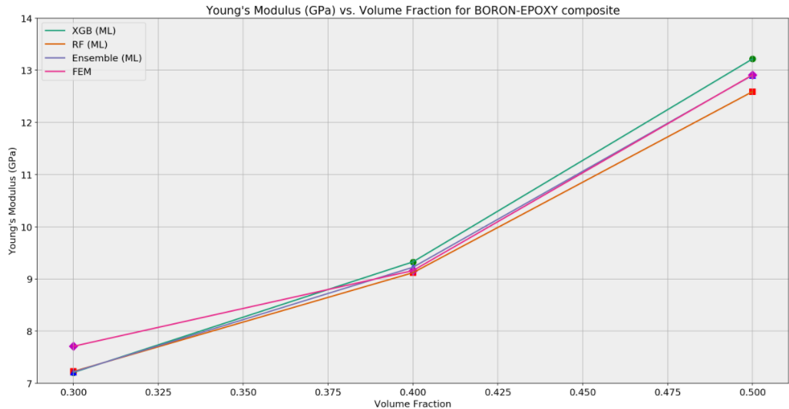
Accuracy Comparison (Young’s Modulus)

Slide 18
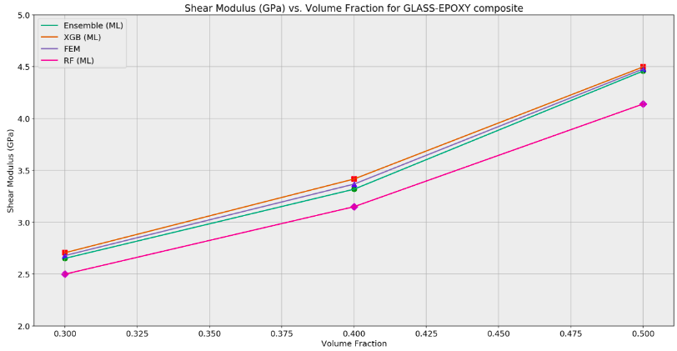
Accuracy Comparison (Shear Modulus)

Slide 19
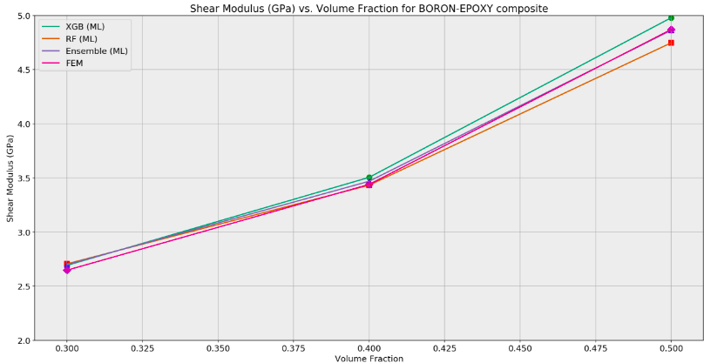
Accuracy Comparison (Shear Modulus)

Slide 20
Activities to be Followed
Creation of GUI with slider panel for tuning parameters like strain, volume fraction, etc., and dynamically training model according to these parameters.
Validation of model by comparison with recorded experimental data, according to an appropriate confidence interval band.
Evaluating and summarising results.

Slide 21
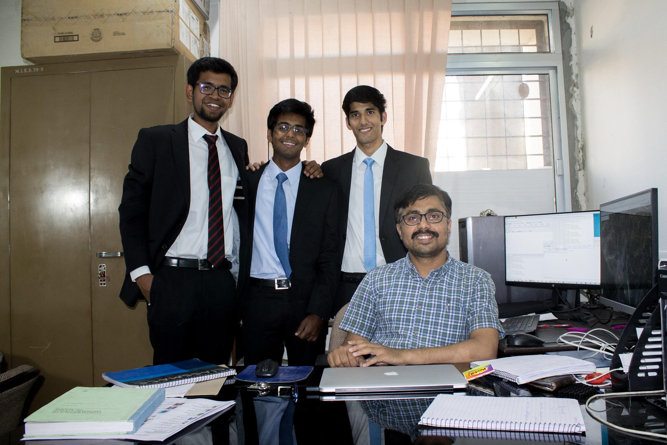
Thank You

